Slide 1
Project Imagine
200 girls and counting...

Slide 2
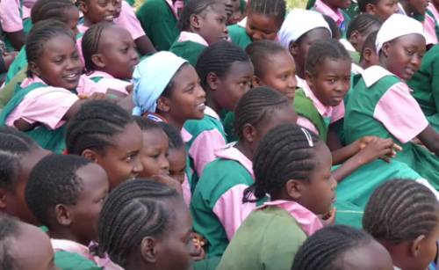
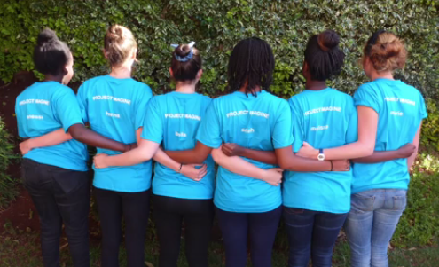
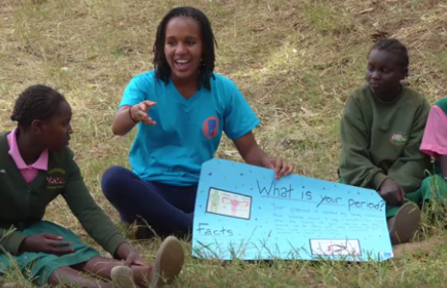
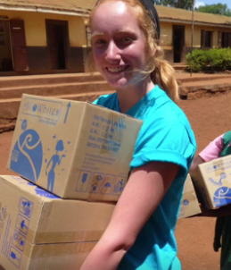
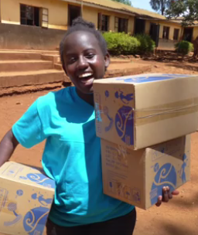
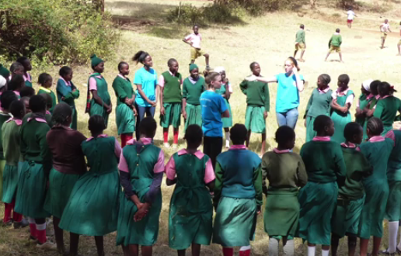
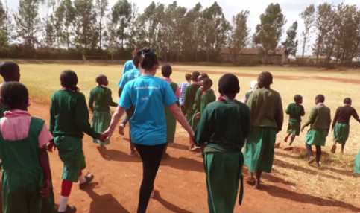
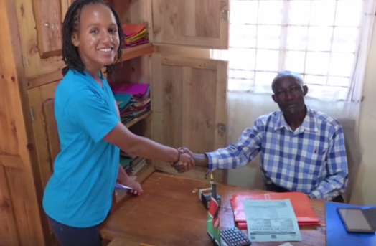
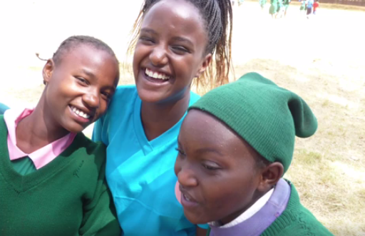
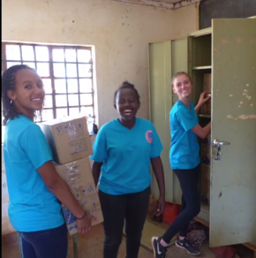
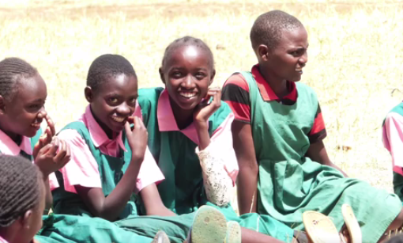
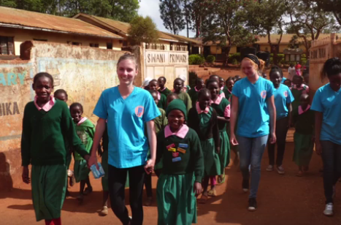
Who Are We?
Summary

Slide 3
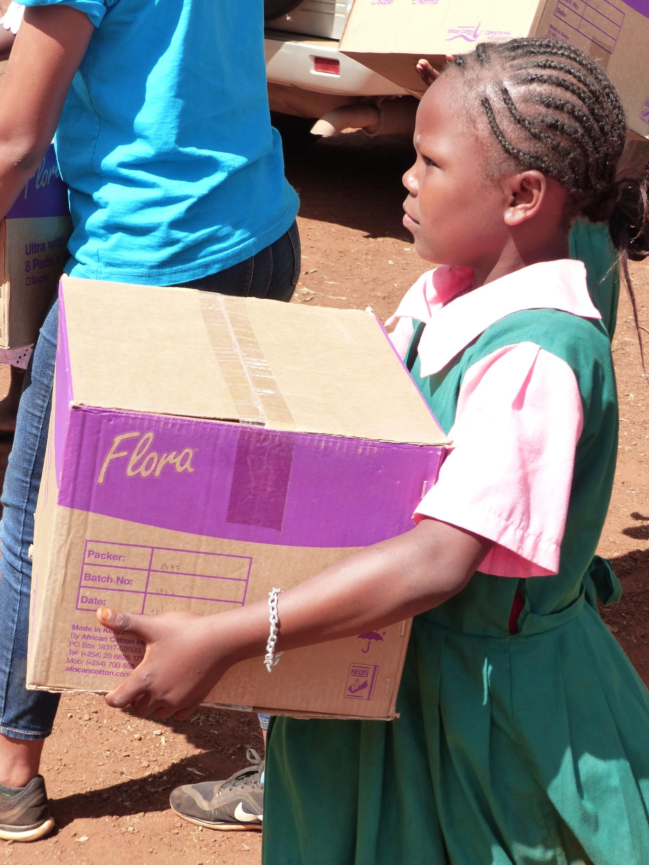
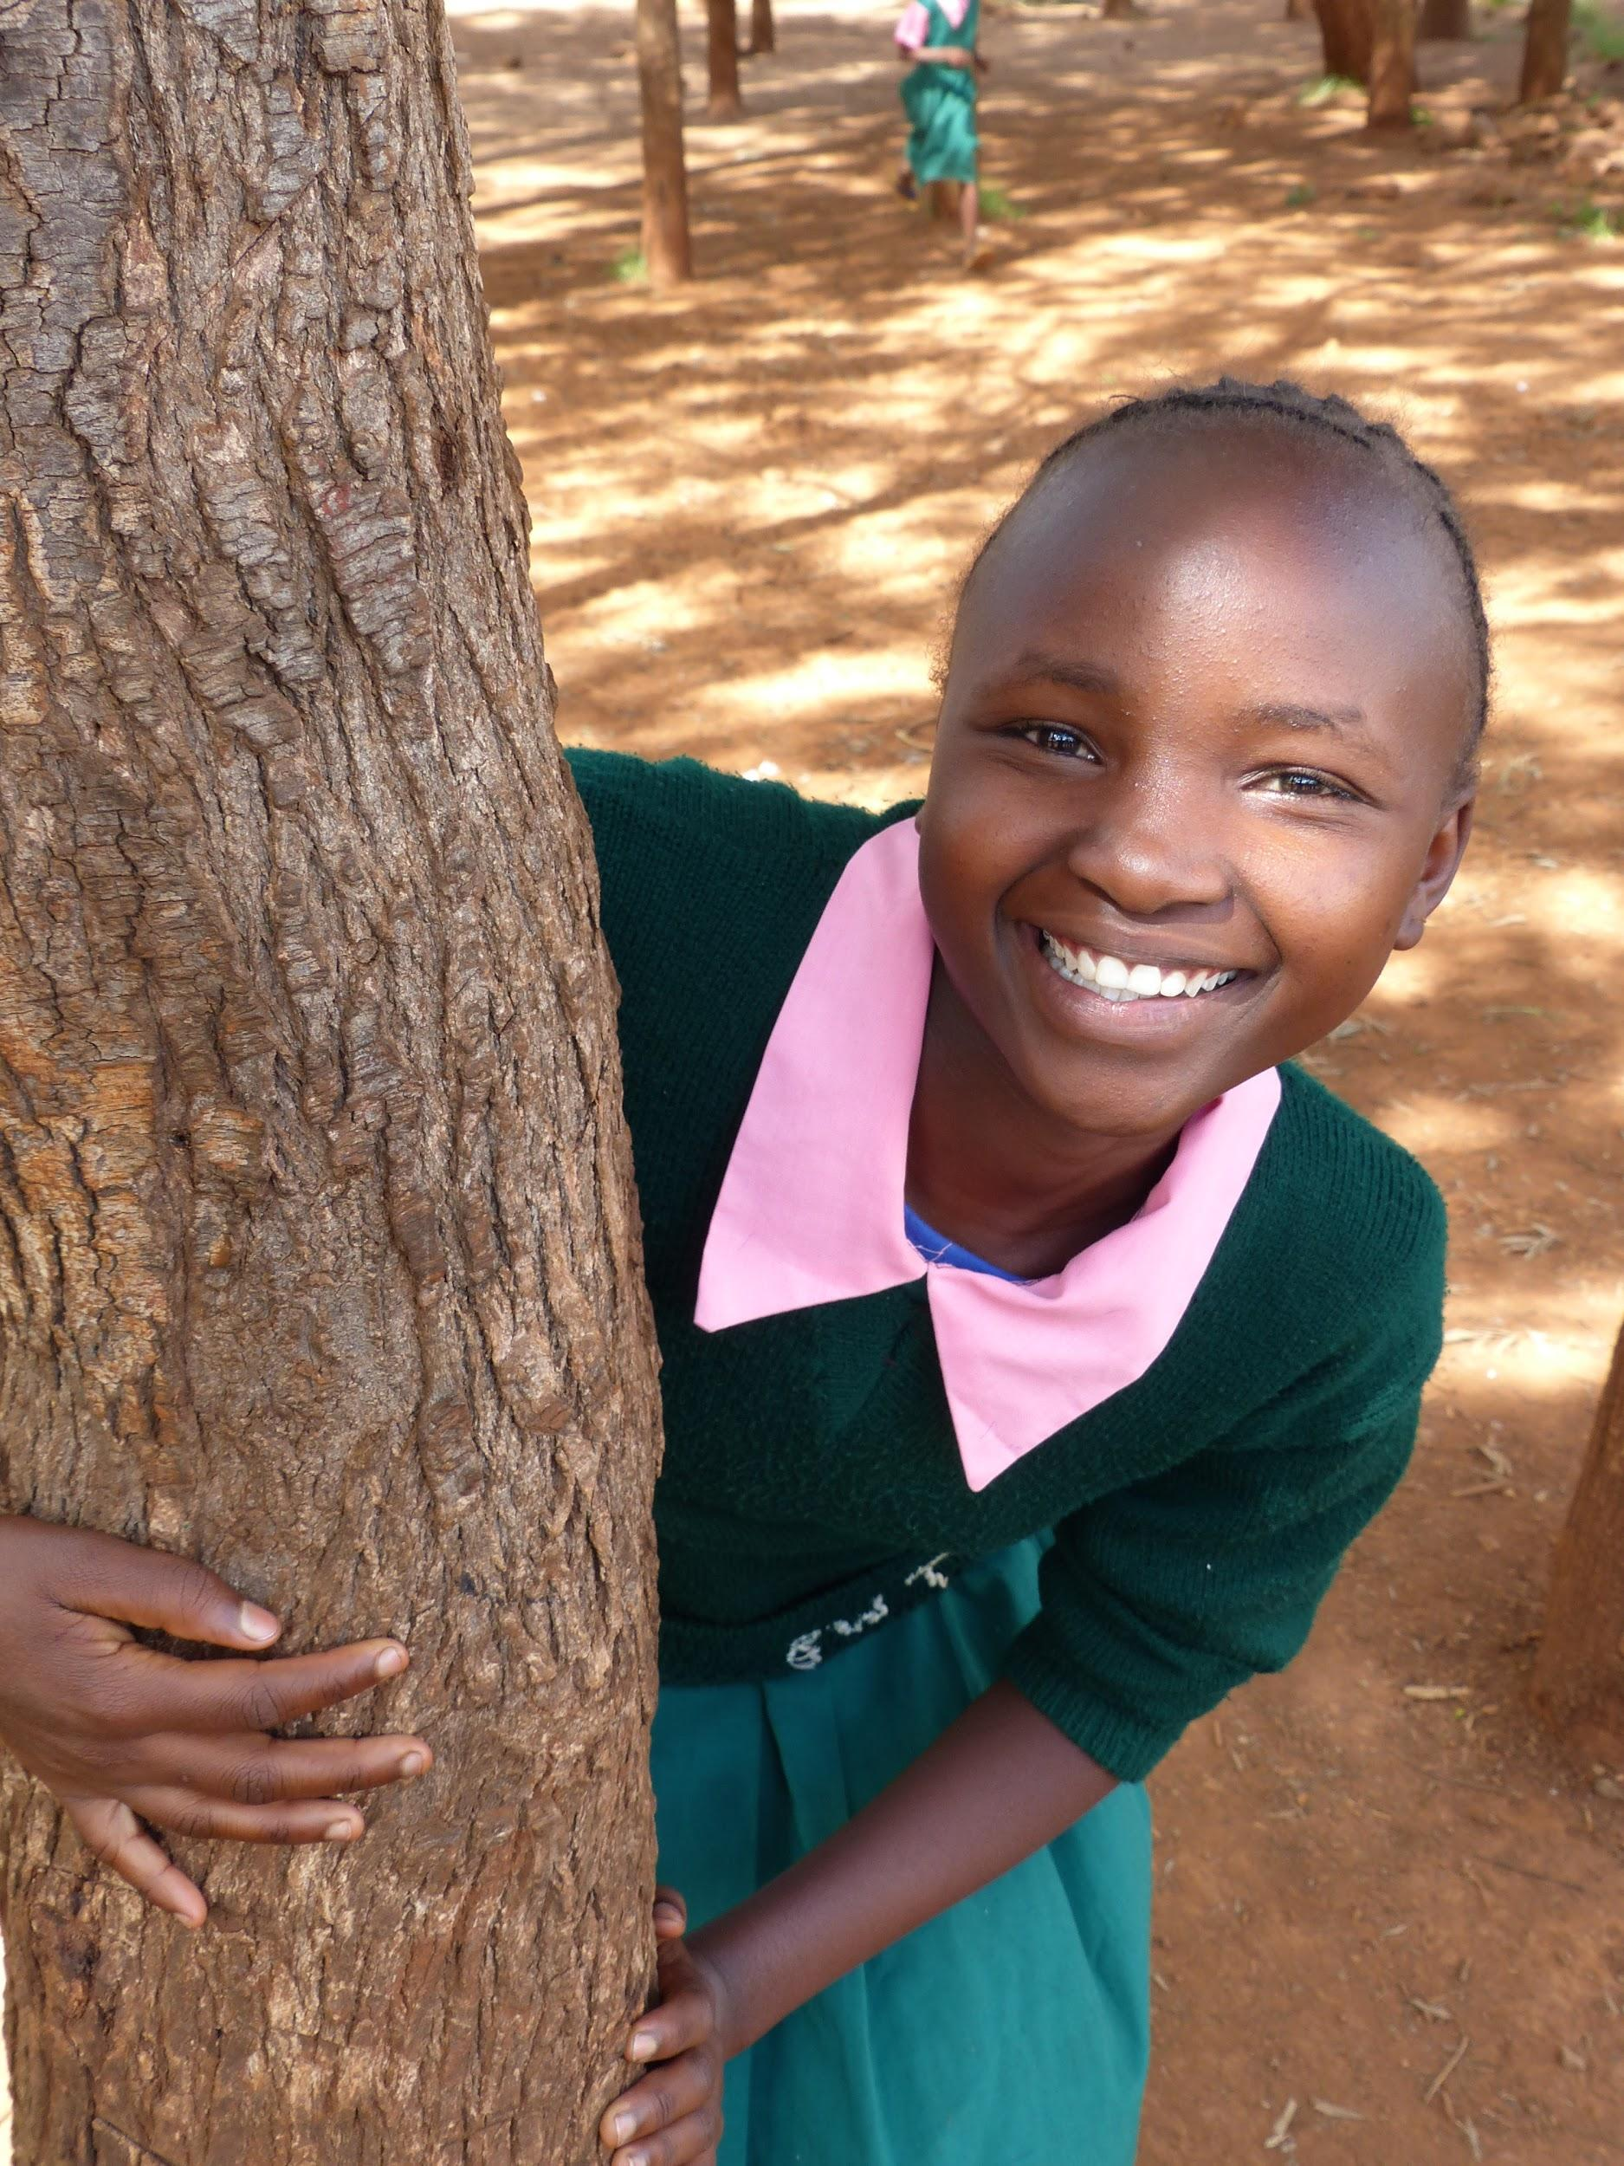
Why Is This Important?
1
Absenteeism
2
Child Marriage
and/or Pregnancy
3
Basic Human Right

Slide 4
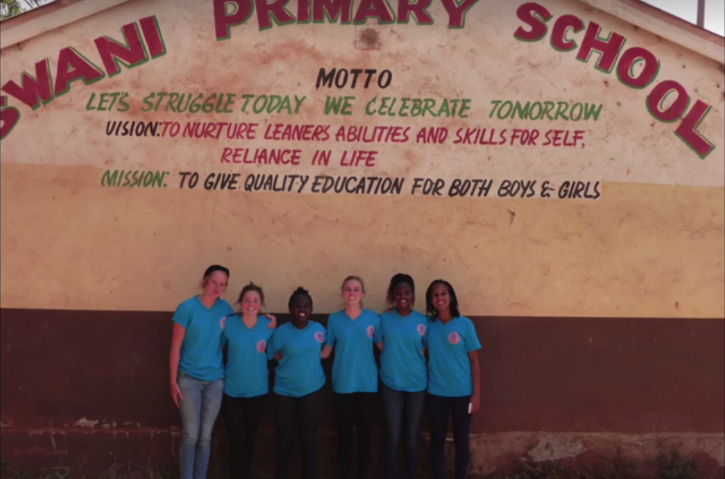
Swani Primary!
Notes:
Ok we really got Swani Primary connected quite closely to Adam, so do you want to bring this up?

Slide 5
So far we have...
Distributed for 5 school terms (1 ⅔ school year)
Distributed over 36,000 sanitary pads to the approx. 200 girls in Class 6,7,8

Slide 6
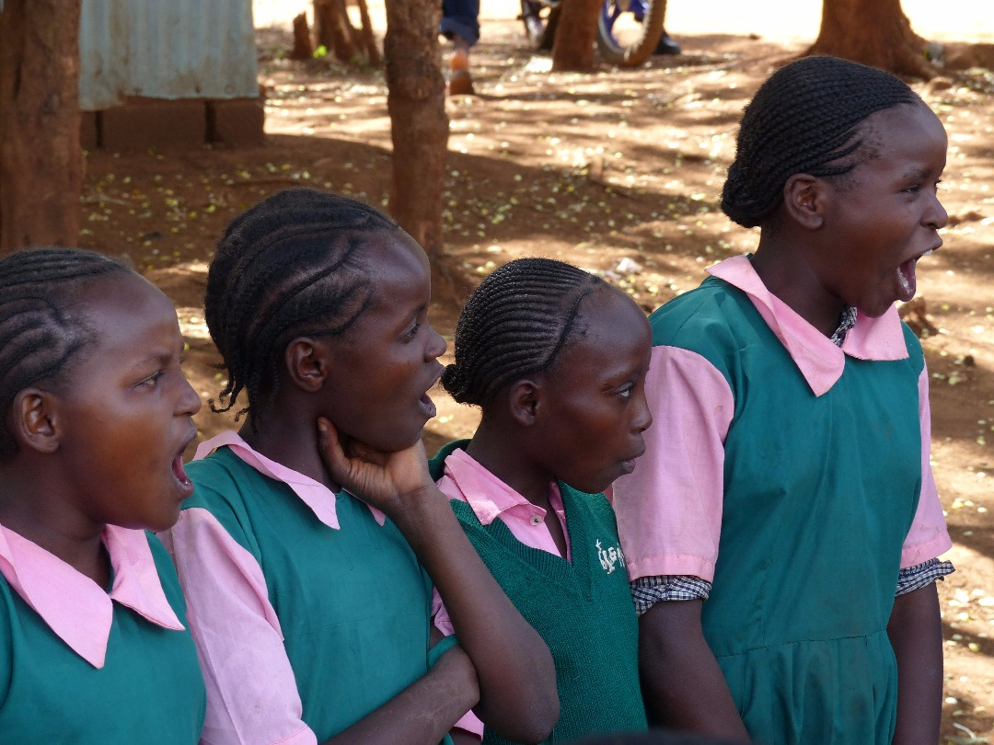
We need you!!
Notes:
“Support Girls Initiative” is where we support 10 girls in their secondary education.

Slide 7
Social Media
Facebook:
https://www.facebook.com/projecttimagine/
Instagram:
https://www.instagram.com/project.imagine/?hl=en
Website:
https://www.projectimagine.net/
Email:
projectimaginekenya@gmail.com
Support us!!
Keep In Touch And Raise Awareness For What We Do!
Notes:
Can Someone put down the correct Project Imagine Email? For some reason I have two.

Slide 8
Thank You;
For Giving Girls a Chance.
The Project Imagine Team
Notes:
We’ll add additional scripts to individually talk about our experience.

